Slide 1



Platform to build and manage
Deep Learning based applications.
BUILD
[ ]
DEPLOY
SCALE

Slide 2
Yatindra Sahu
Google MLCC Facilitator | Data Analyst
Python Programmer | Freelancer
WebSite : pymacbit.github.io
Twitter : pymacbit
LinkedIn : linkedin.com/in/pymacbit/
Siddhant Sharma
Data Analyst | E-Commerce Specialist |
Freelancer
LinkedIn: linkedin.com/in/siddhantsharmacse/
Instagram : instagram.com/vjsiddhant/

Slide 3


Mission
Simplify Deep Learning
with ‘tools’ powered by ‘Deep Learning’

Slide 4
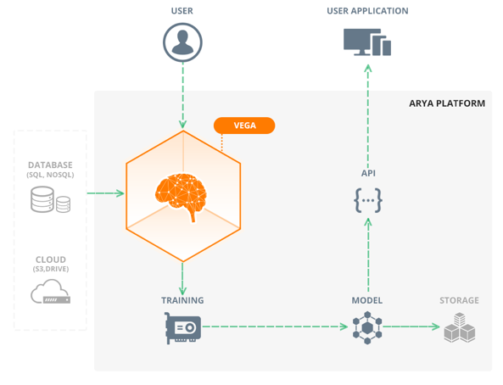
Arya.ai
Simplifying ‘Deep Learning’
Arya.ai solves the complex ‘AI’ build-out process thus enabling enterprises to focus on product features and differentiations
For enterprise
‘VEGA’ Enterprise
On Cloud
‘VEGA’ Cloud

Slide 5




How it is better?
Easy to build Neural Net Architecture
Drag and drop interface & meta frame-work for Deep Learning
Customizations are automated
(NN - data customizations) can be simulated rather doing manually.
Faster training
With personalized computing allocation, training is quicker and optimized
Data/Domain agnostic
Same platform for multiple use cases that can handle any kind of data set

Slide 6
ADD-ONS
Personalize the workbench for your requirements
NEURAL NETWORKS
APIs
Platform Solutions
General Adversarial Networks
Aspect based Sentiment classification
Face Matching
(age extrapolation)
Business Analysis systems
using emails
Deep CNN language modelling
Temporal attention models
Diabetic Retinopathy
Machine performance optimization
Object Segmentation
Assistive Consulting Systems
Multi-agent reinforcement learning
Fused Recurrent & Convolutional neural nets
Action recognition in videos
Intelligent Automation – Cheque Processing
Hierarchical Memory networks
More….
Long context sentiment analysis
More….
Multi-functional predictive modelling

Slide 7



To try out the platform
PS: Also ask for detailed white papers on how to use Vega in:
Finance, Insurance, Banking, Medicine, Energy & Retail
Visit website – arya.ai
Use ‘Vega’ on cloud – cloud.arya.ai
Tools to simplify complex tasks in building
‘Deep Learning’ systems
“The Leading Millennial Consumer Tech Founders In Asia”
Hot startup: Algorithm for artificial intelligence is this startup's code
Top 4 Next Gen Technology startup - among 54 countries

Slide 8

Learn to predict
Game of Thrones

Slide 9
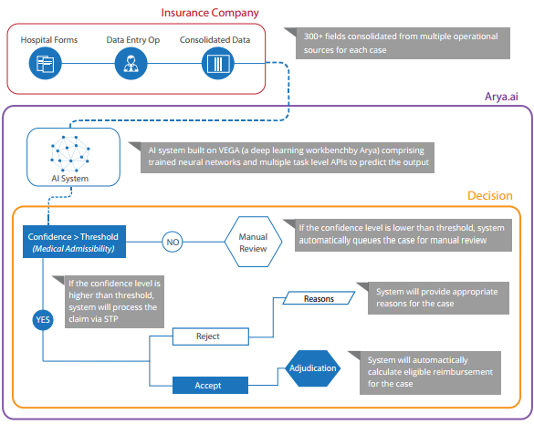
Use Case: Health Claim Automation

Slide 10
Deep Learning in Computer Vision
Teaching computers to see…

Slide 11
“As a scientific discipline, computer vision is concerned with the theory behind artificial systems that extract information from images or videos” - Wikipedia
Information can be -
Object recognition eg. car, pedestrians
Pose estimation eg. Where is the car relative to the camera
Face recognition eg. Unlocking Iphone X
Optical Character recognition (OCR) eg. Characters in an image
Tracking or motion analysis.
And lot more...

Slide 12

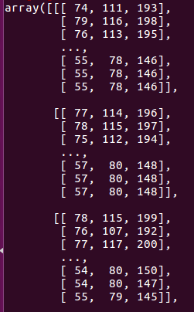
What humans see
What computers see

Slide 13
Why teach computers to see?
Automate repetitive processes like product defects on assembly line.
Smart visual surveillance
Intelligent traffic management system
Camera based precision diagnosis
Smart biometrics
Driverless cars and many more...

Slide 14
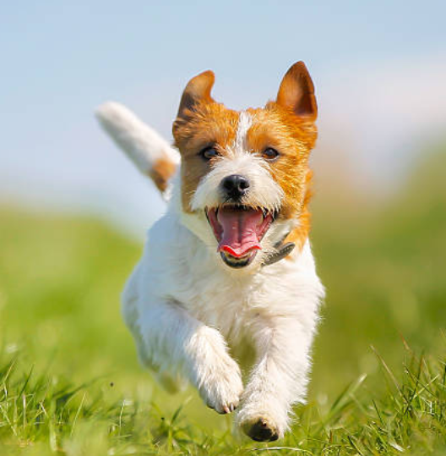
Object Classification
A dog
A dog

Slide 15
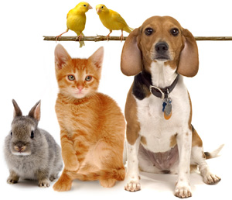
How to classify?
Multiple animals (classes)
Many animals (classes)

Slide 16
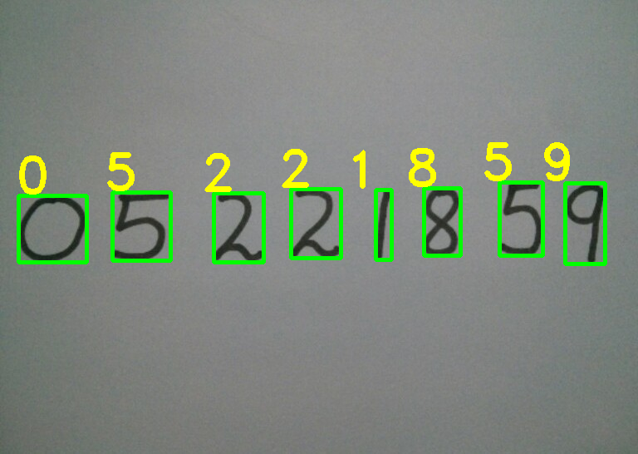
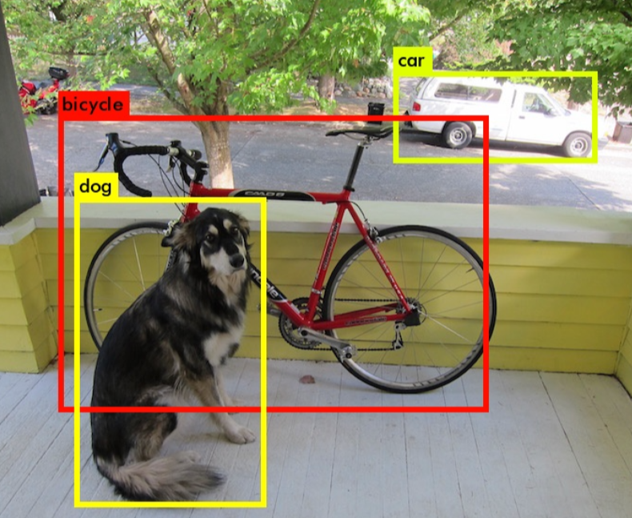
Object Detection
Not only recognize what the objects are inside a given image but also locate where they are in the image

Slide 17
Object detection algorithms
Viola-Jones algorithm (2001) - mainly for face detection.
Histogram of oriented gradients (2005) - mainly for face and pedestrian detection
R-CNN (Region based Convolutional Neural Networks)
Fast and Faster R-CNN
YOLO (You only look once) - current state of the art.

Slide 18
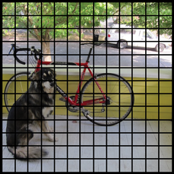
YOLO V2 (You Only Look Once)
YOLO actually looks at the image just once, hence the name You Only Look Once.
It divides the image into 13 by 13 cells.

Slide 19
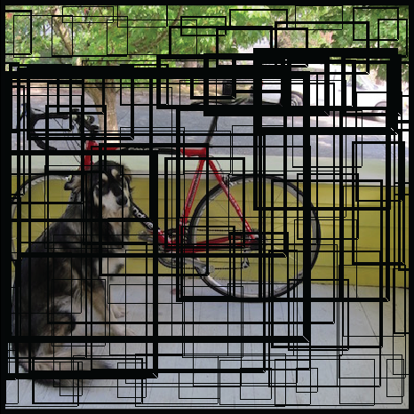
Each cell is responsible for predicting 5 bounding boxes.
It also predicts a confidence score representing if the bounding box contains some object
The score doesn’t say anything about what kindof object is in the box, just if the box contains any particular shape.
The higher the confidence score, the fatter the bounding box

Slide 20
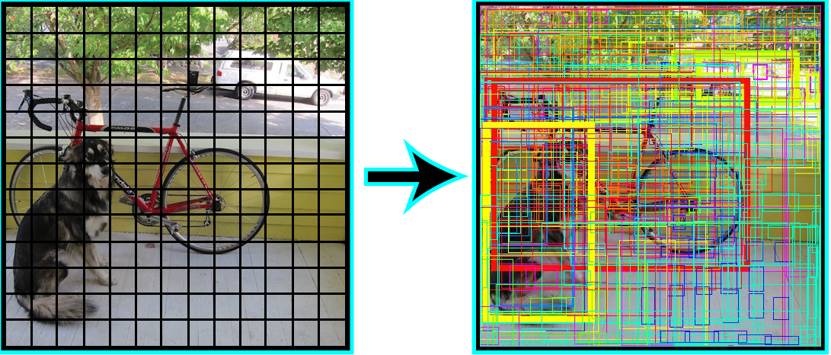
For each bounding box, the cell also predicts a class.
The model when trained on PASCAL VOC dataset, can detect 20 different classes.
The confidence score and class prediction are combined which tells us that the particular bounding box contains a specific type of object (Dog)

Slide 21
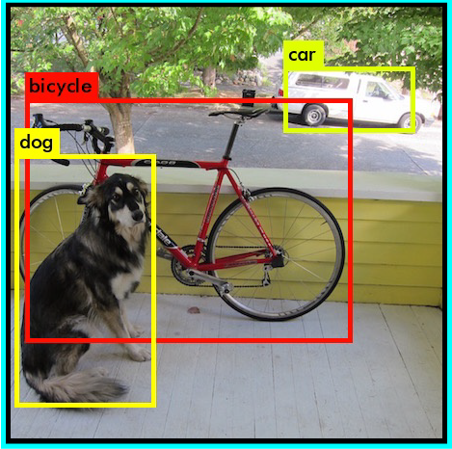
Each cell predicts 5 bounding boxes, hence total of 13x13x5 = 845 bounding boxes are predicted for each image.
But setting a threshold value like 30% on the final combined score (confidence and class probabilities), removes majority of the bounding boxes.
Final prediction -

Slide 22
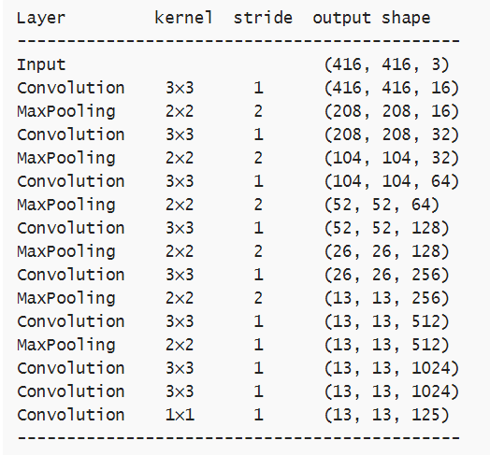
Tiny YOLO architecture

Slide 23
Why is YOLO so powerful?
Although the algorithm predicts 845 bounding boxes, it predicts the bounding boxes all at once by looking at the image only once.
The very last convolutional layer has a 1×1 kernel and exists to reduce the data to the shape 13×13×125.
These 125 numbers contain the data for the bounding boxes and the class predictions.
Each grid cell predicts 5 bounding boxes and a bounding box is described by 25 elements:
x, y, width, height for the bounding box’s rectangle
the confidence score
the probability distribution over the 20 classes

Slide 24
YOLO in action...

Slide 25
Questions?

Slide 26
Links and resources
YOLO V1 paper - link
YOLO V2 paper - link
YOLO weights - link
YOLO in Tensorflow - link
YOLO in Keras - link
Joseph Redmon’s TED Talk - link
CVPR presentation - link

Slide 27

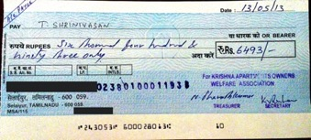
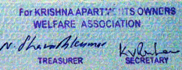
Use Case: Cheque Clearing Application
EXTRACT
Cheque Clearing Automation
MICR
Date
Amount in Words
Approach:
An ‘AI’ application that can learn Autonomously from historical data and adapt from live data
Account No
Amount
MATCH
Segmentation
Signatures & Roles
Amount in Words
Amount

Slide 28
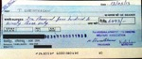


Cheque clearing application: Training & Parallel Run
Training the system
Parallel Run
After training on sample training data, the system is then left to learn autonomously from live information until it starts predicting with utmost confidence
Sample set of Previously verified Cheques of every month for the past 12 months
Training Data
Live data
Manually extracted information
Date:
Amount:
Account Num:
Signature: Matched…
Cheque Clearing application
Outsourcing Vendor
Cheque Images
Cheque Clearing application
Feedback data
Machine output
Human output

Slide 29

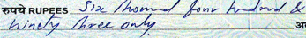
Use case: Cheque Automation using Computer Vision
CURRENT
Manual process
Time to process: 180s
Cost/Cheque: INR 0.8
False Positive: 1.3%
With Arya.ai
44% completely automated & 67% partial Automated
Time to process: 0.8s
(225 times faster)
Cost/Cheque: INR 0.023
(29 times cheaper)
False Positive: 0.7%
(60% more accurate)
Cheque Transaction Automation
Account No
Signatures & Roles
Amount
Date
Amount in Words
MICR

Slide 30
GUESS THE CELEBRITY

Slide 31
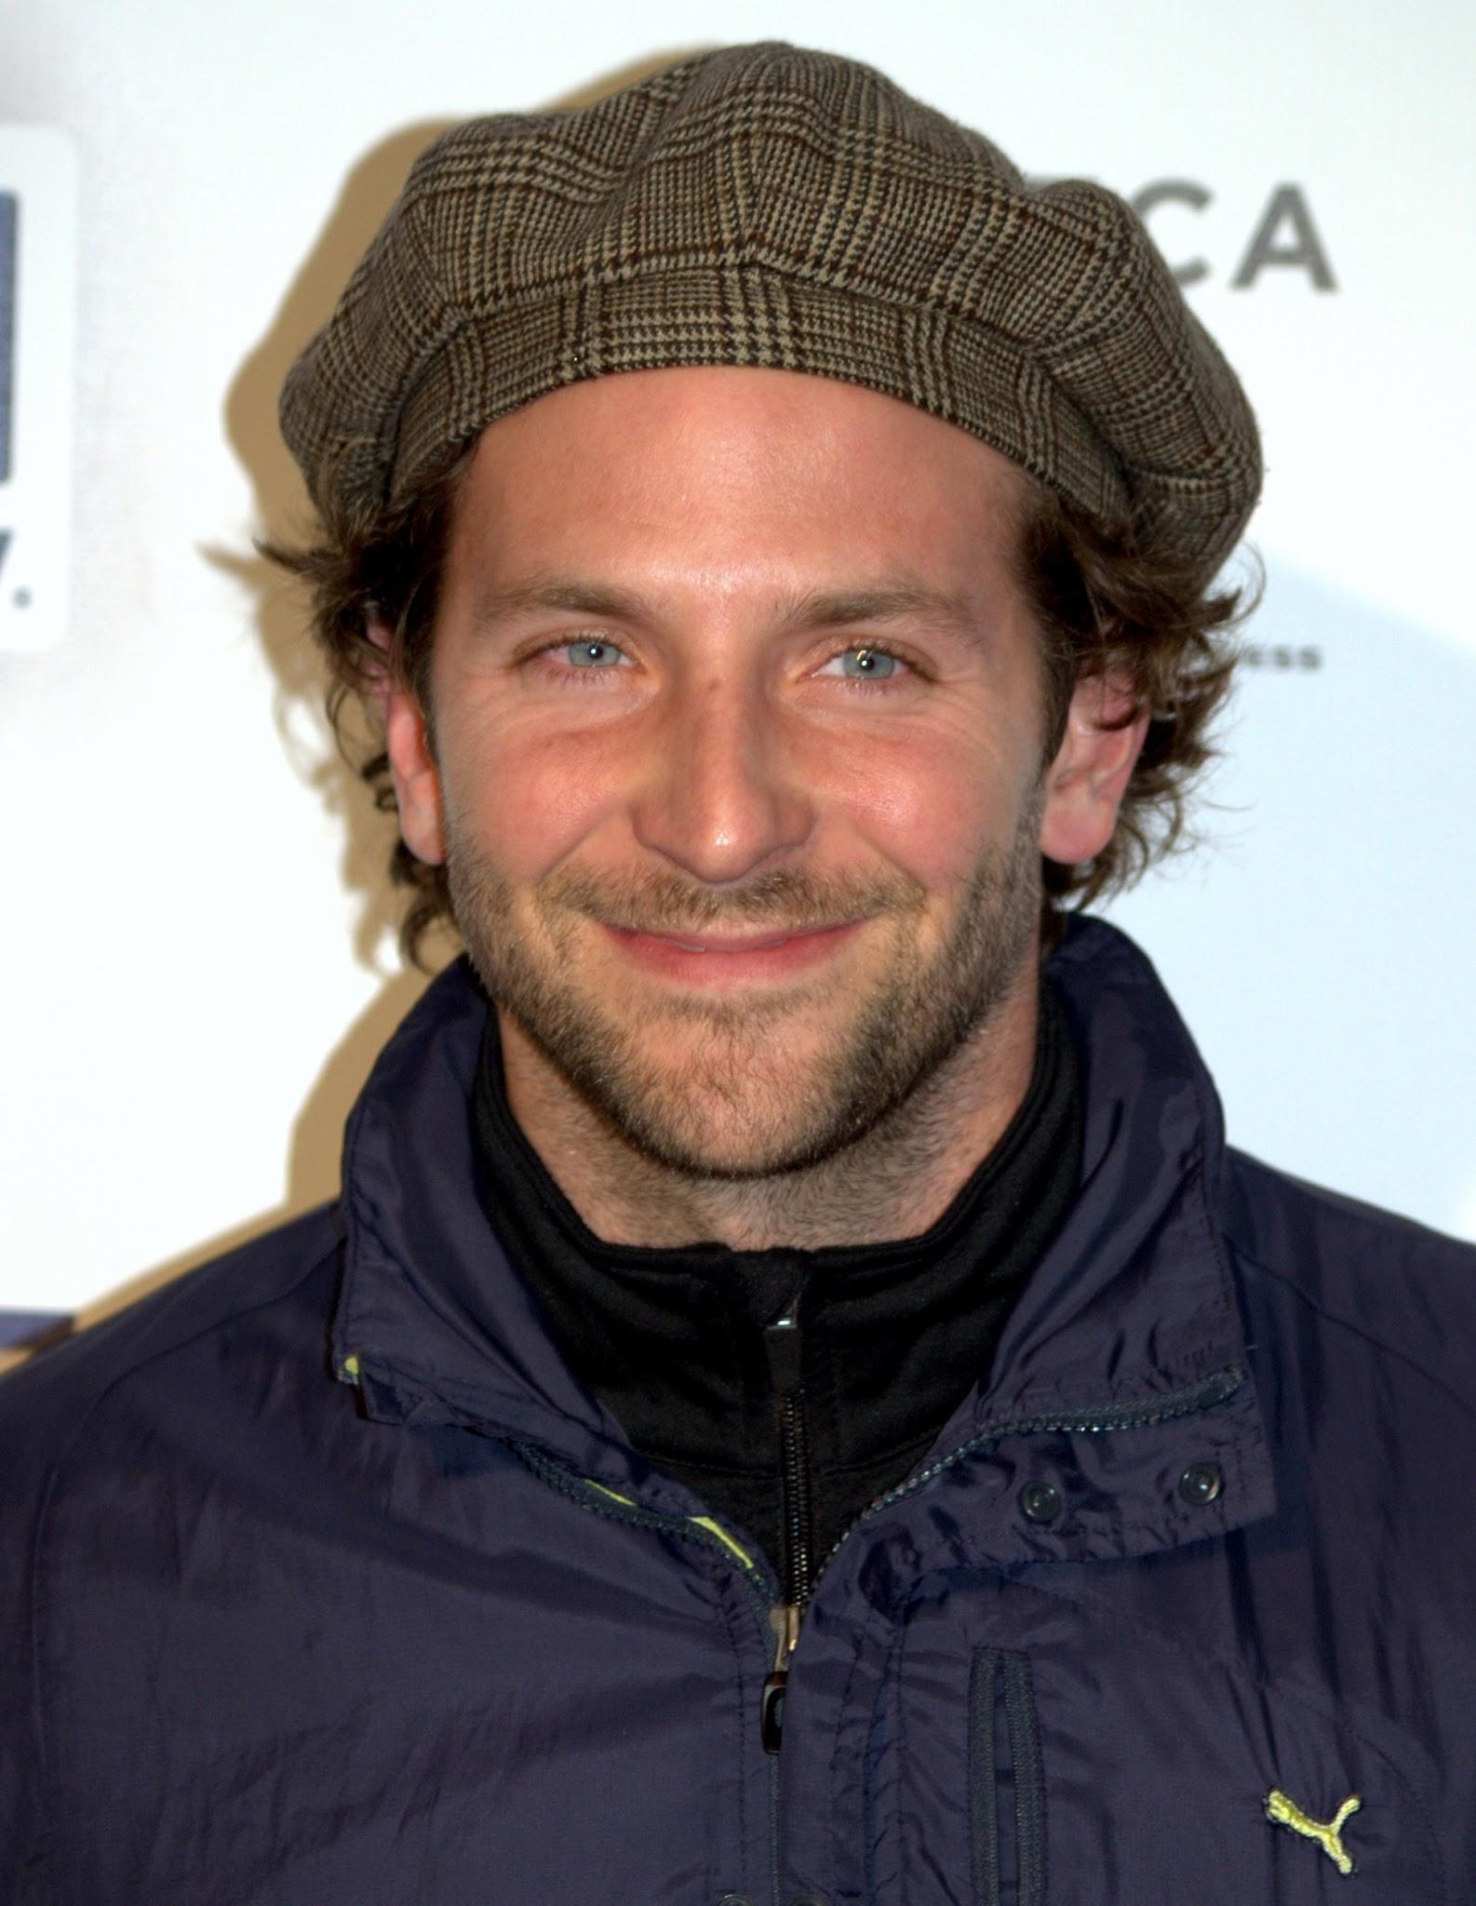
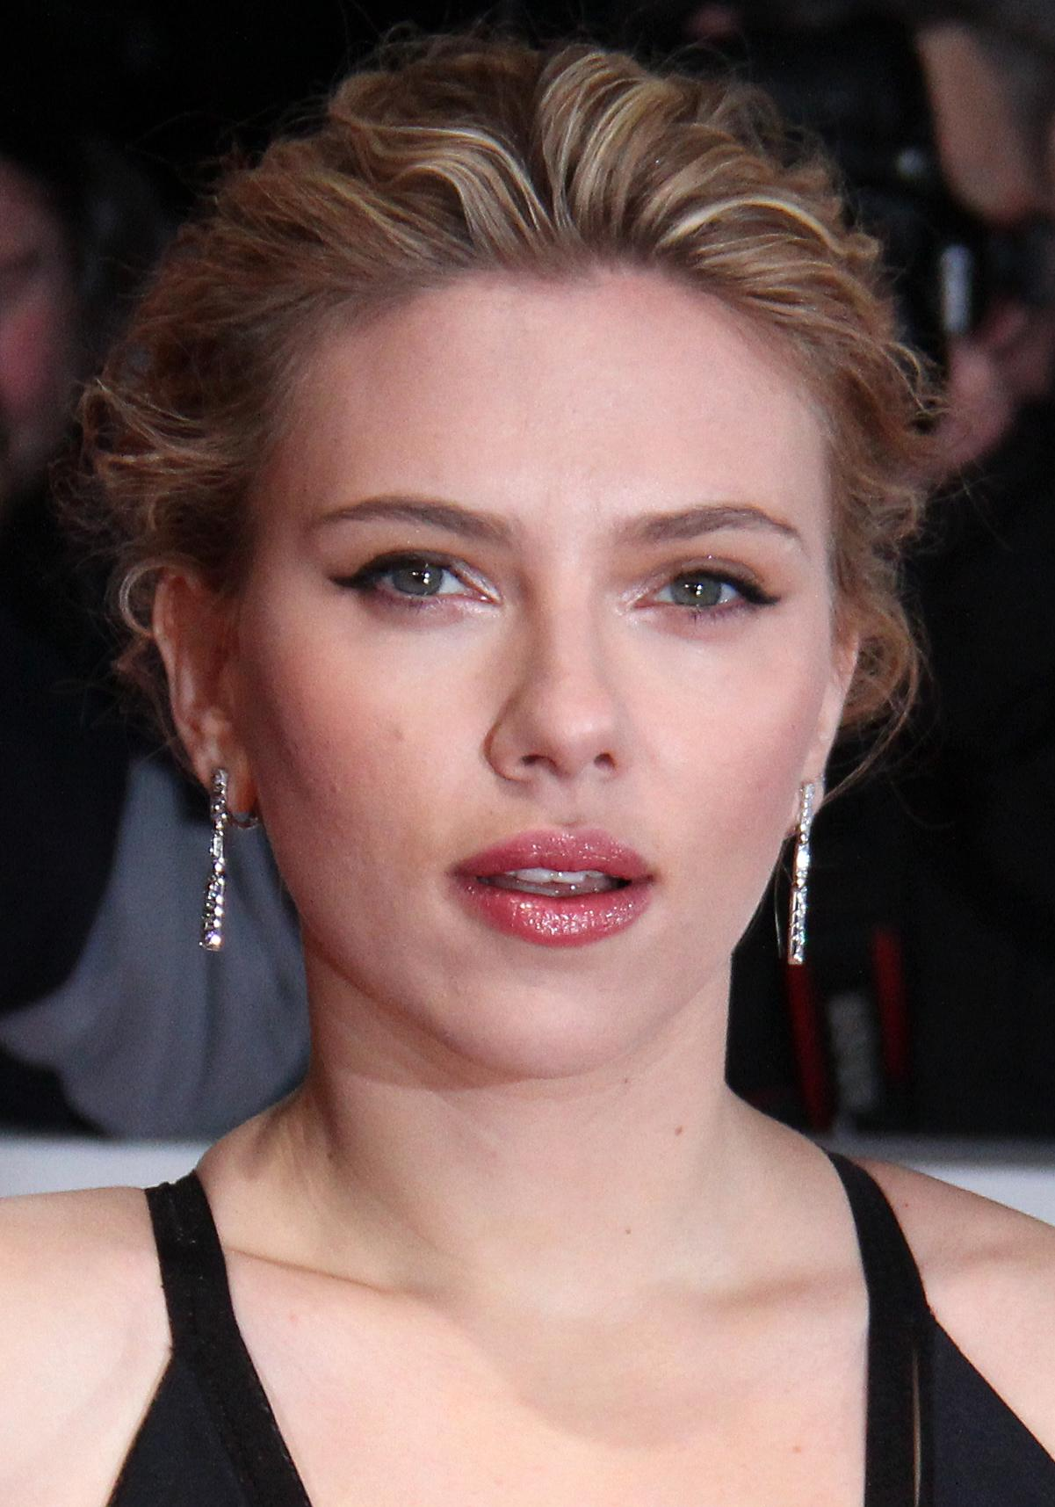
GUESS WHO THEY ARE?

Slide 32
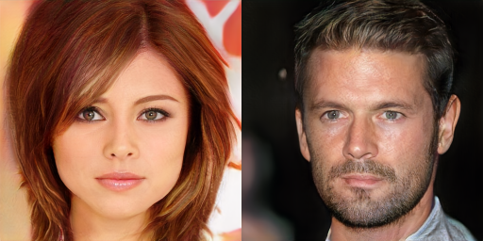
GUESS WHO THEY ARE?

Slide 33
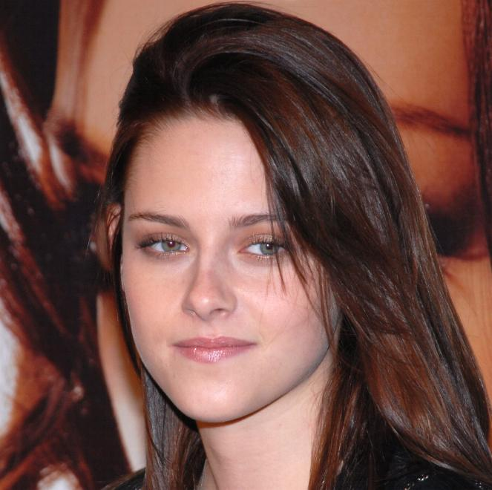
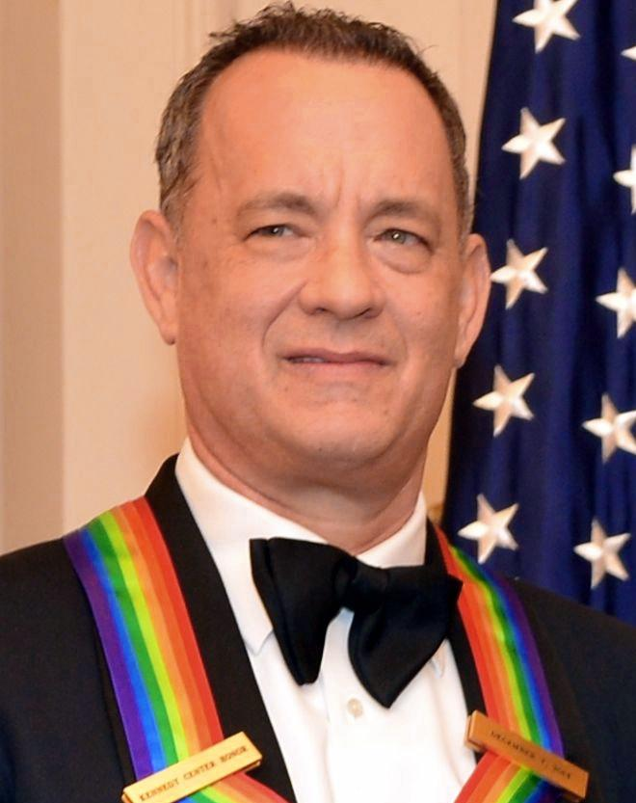
GUESS WHO THEY ARE?

Slide 35
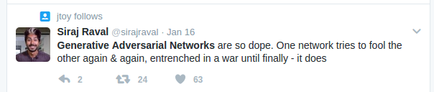
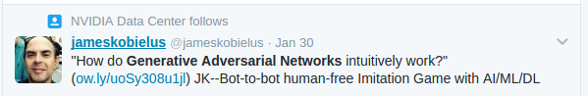

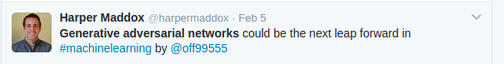
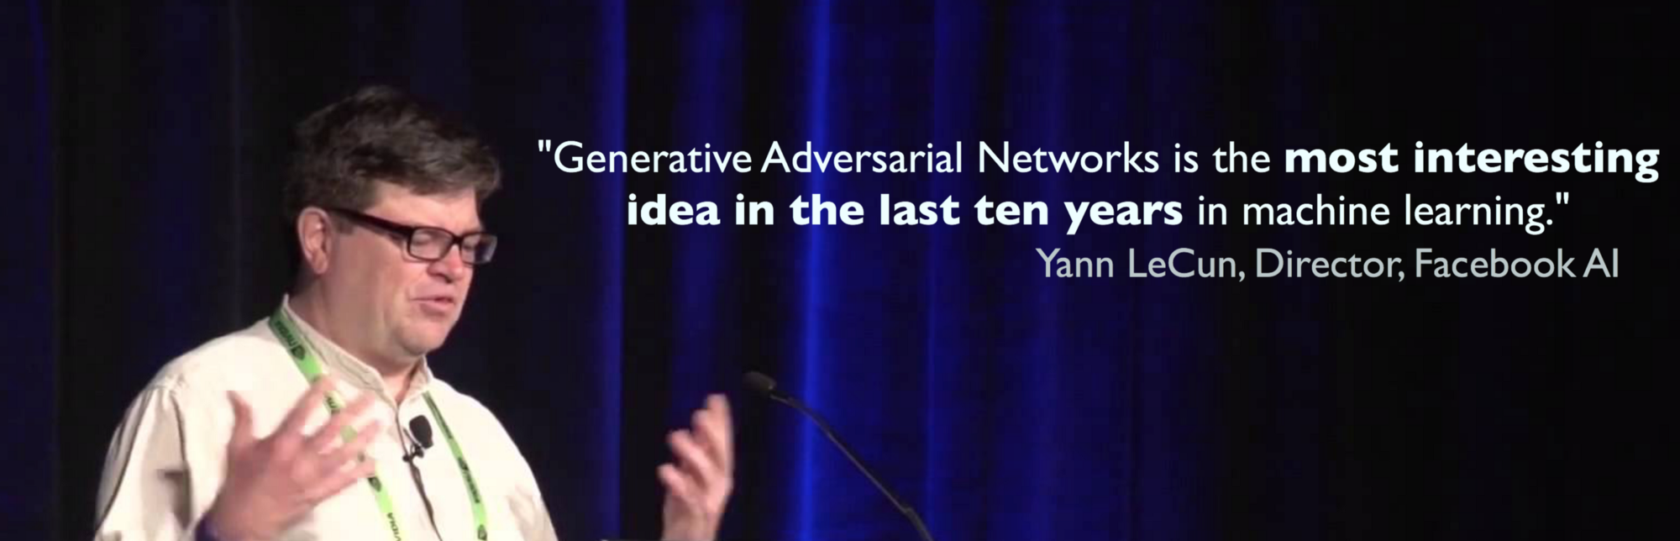

Slide 36
What is the fuss about GANs?
What do they do?
“What I cannot create, I do not understand.”
—Richard Feynman

Slide 37
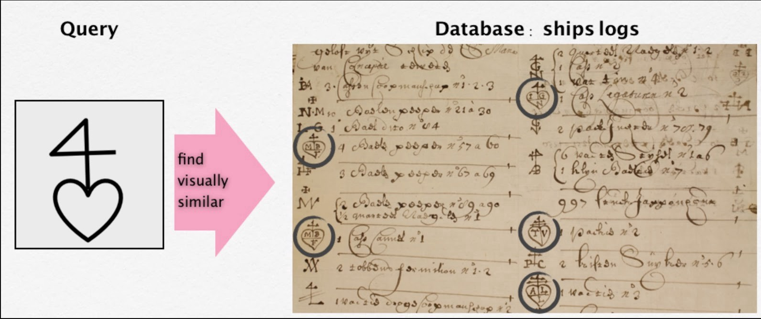
Image Search

Slide 38
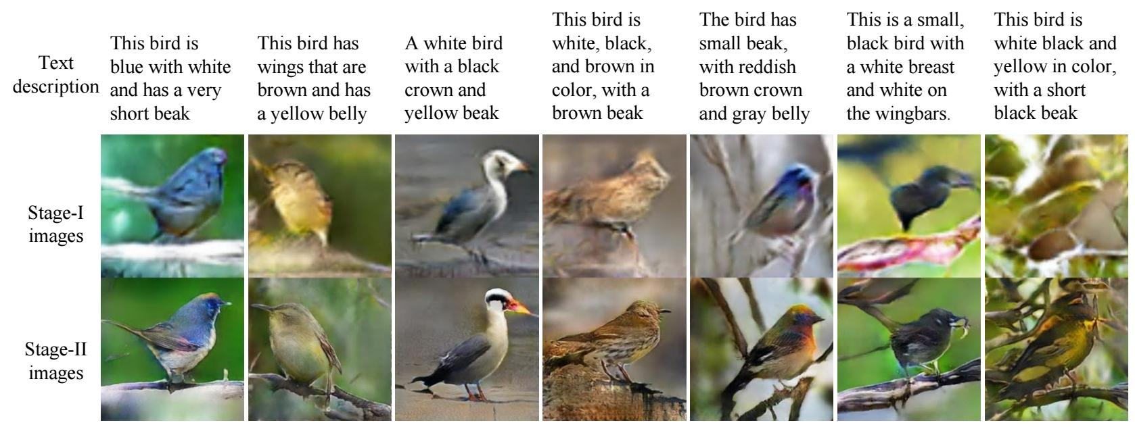
Text to Image generation

Slide 39
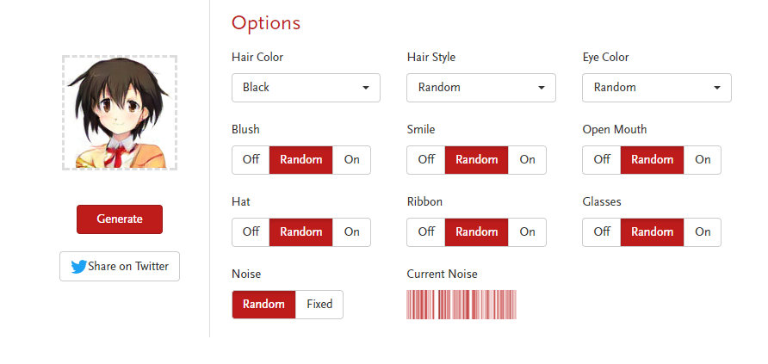
Anime Character Generation (http://make.girls.moe/)

Slide 40
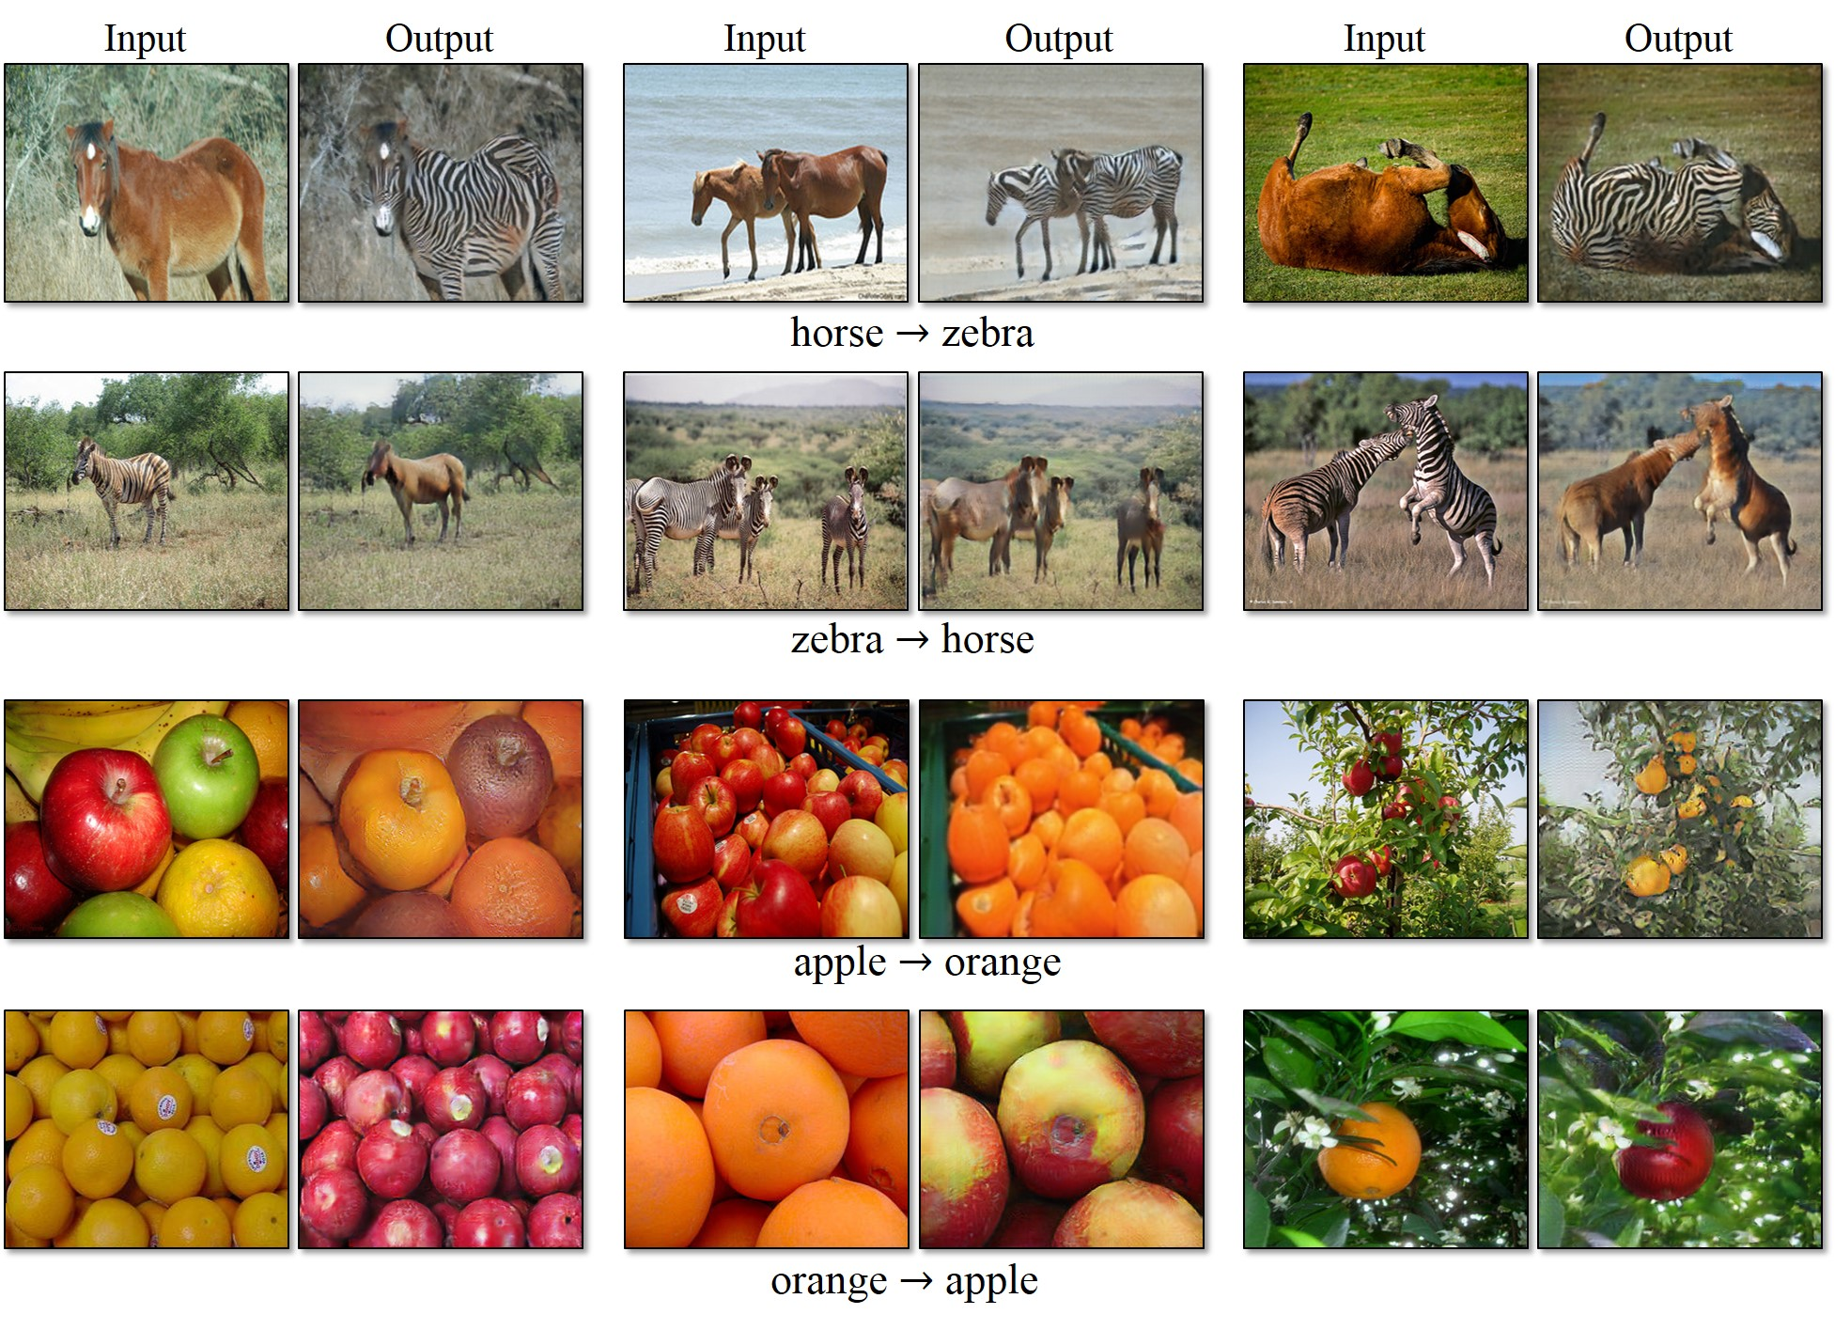
Image Translation

Slide 41
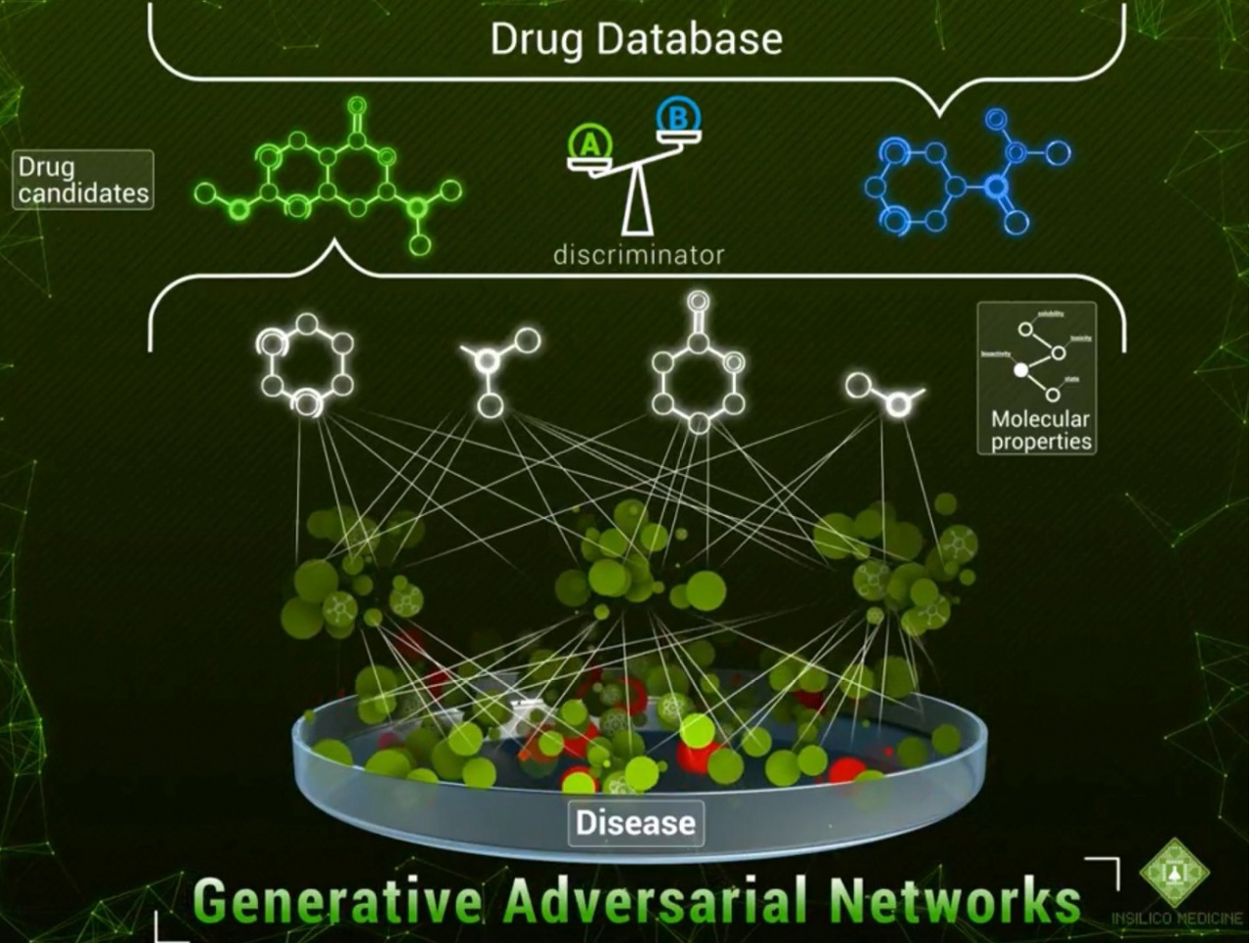
Drug Discovery

Slide 42
How does it work?
Source : Yunjey Choi NAVER seminar talk.

Slide 43
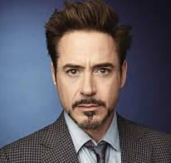
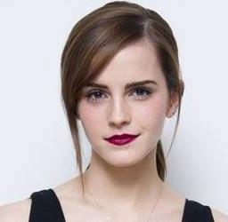
Supervised Learning
Input image
(64x64x3)
(1)
(1)
Discriminative
Model
man woman
(2)
(2)
The discriminative model learns how to classify input to its class.
‹#›

Slide 44
Unsupervised Learning
Latent code (100)
Generative
Model
Image
(64x64x3)
The generative model learns the distribution of training data.
‹#›

Slide 45
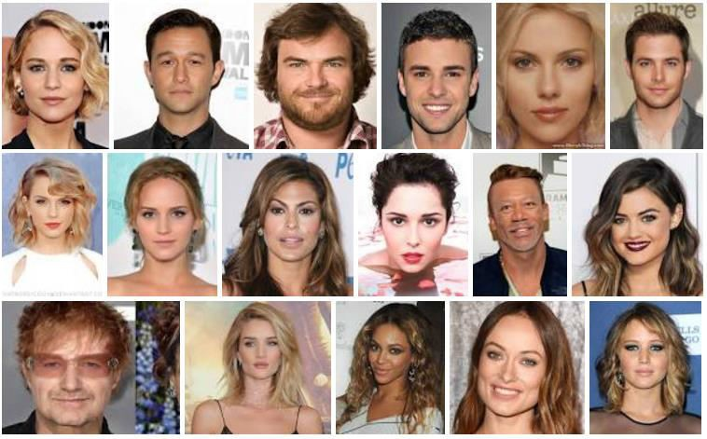
Probability Distribution
Generative Model
What if x is actual images in the training data?
At this point, x can be represented as a (for example) 64x64x3 dimensional vector.
‹#›

Slide 46
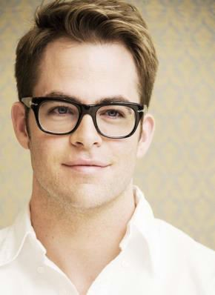
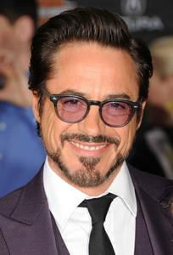
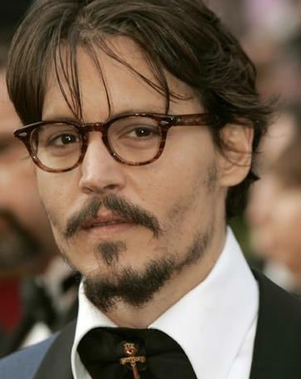
Probability Distribution
Generative Model
Let’s take an example with human face image dataset.
Our dataset may contain few images of men with glasses.
x is a 64x64x3 high dimensional vector representing a man with glasses.
‹#›

Slide 47
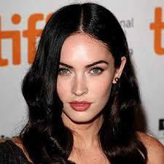
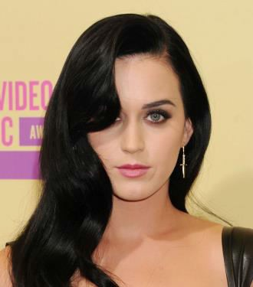
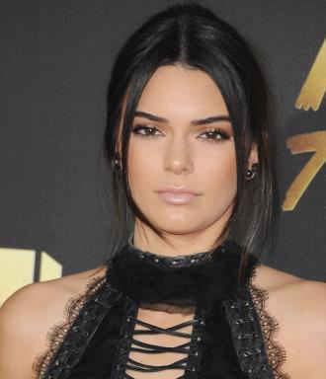
Probability Distribution
Generative Model
Our dataset may contain many images of women with black hair.
The probability density value is high
x is a 64x64x3 high dimensional vector
representing a woman with black hair.
‹#›

Slide 48
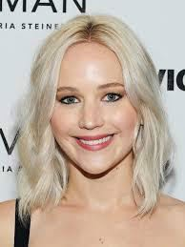
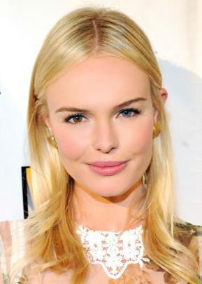
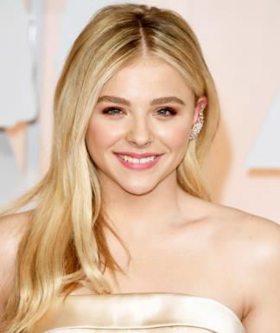
Probability Distribution
Generative Model
Our dataset may contain very many images of women with blonde hair.
The probability density value is very high
x is a 64x64x3 high dimensional vector representing a woman with blonde hair.
‹#›

Slide 49
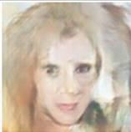
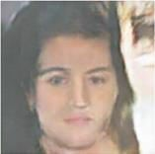
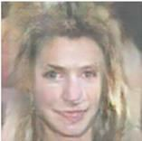
Probability Distribution
Generative Model
Our dataset may not contain these strange images.
The probability density value is almost 0
x is an 64x64x3 high dimensional vector representing very strange images.
‹#›

Slide 50

Game Theory
Generative Model
Generator
Discriminator
Learn to Generate sample
Learn to fool discriminator from the scores it gives.
Learn to discriminate between real image and fake image

Slide 51
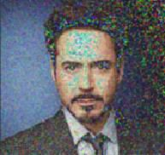
Intuition in GAN
May be high
D
D(x)
The probability of that
x came from the real data (0~1)
Training with real images
x
Discriminator
Real image
Generator
Training with fake images
z
G
D
D(G(z))
May be low
Latent Code
G(z)
Fake image
17

Slide 52
Intuition in GAN
The discriminator should classify a real image as real.
D
D(x)
This value should
be close to 1.
x
Discriminator
(Neural Network)
Real image
(64x64x3)
18

Slide 53
Intuition in GAN
Generator
The discriminator should classify a fake image as fake.
z
D
D(G(z))
This value should
be close to 0.
G(z)
Fake image generated by the generator
19

Slide 54
Intuition in GAN
x
Generator
(Neural Network)
z
G
D
D(G(z))
This value should
be close to 1.
Latent Code (100)
The generator should create an image that is indistinguishable from real to
G(z)
Generated image
deceive the discriminator
‹#›

Slide 55
Objective of GAN
D
D(x)
x
Train D to classify real images as real
Training with real images
Training with fake images
z
G
D
D(G(z))
G(z)
Train D to classify fake images as fake
‹#›

Slide 56
Resources
Courses
Andrew Ng’s Machine Learning & Deep Learning Course
Fast.ai’s deep learning course
Udacity AI nano degree
Podcasts
This Week in ML and AI (TWIML)
Data Sceptic
Partially Derivative
Youtube Channels
Sirajology
3 Blue 1 Brown
Blogs
Distill.pub
WildML
Andrej Karpathy’s Blog
Newsletters
machinelearningmastery
ImportAi
Deeplearningweekly
CityAI

